Slide 1
Al-Farabi Kazakh National University
Higher School of Medicine
FLUID AND ELECTROLYTE BALANCE

Slide 2
Часть

Slide 3
LEARNING OUTCOMES
As a result of the lesson you will be able to:
Name the major fluid compartments and explain how water moves from one to another;
list the body’s sources of water and routes of water loss;
describe the mechanisms of regulating water intake and output;
describe some conditions in which the body has a deficiency or excess of water or an improper distribution of water among the fluid compartments.
Al-Farabi Kazakh National University
Higher School of Medicine

Slide 4
Balance
cellular function requires a fluid medium with a carefully controlled composition
three types of homeostatic balance
water balance
average daily water intake and loss are equal
electrolyte balance
the amount of electrolytes absorbed by the small intestine balance with the amount lost from the body, usually in urine
acid-base balance
the body rids itself of acid (hydrogen ion – H⁺) at a rate that balances metabolic production
balances maintained by the collective action of the urinary, respiratory, digestive, integumentary, endocrine, nervous, cardiovascular, and lymphatic systems

Slide 5
Body Water
newborn baby’s body weight is about 75% water
young men average 55% - 60%
women average slightly less
obese and elderly people as little as 45% by weight
total body water (TBW) of a 70kg (150 lb) young make is about 40 liters

Slide 6
Fluid Compartments
major fluid compartments of the body
65% intracellular fluid (ICF)
35% extracellular fluid (ECF)
25% tissue (interstitial) fluid
8% blood plasma and lymphatic fluid
2% transcellular fluid ‘catch-all’ category
cerebrospinal, synovial, peritoneal, pleural, and pericardial fluids
vitreous and aqueous humors of the eye
bile, and fluids of the digestive, urinary, and reproductive tracts

Slide 7
Water Movement Between Fluid Compartments
fluid continually exchanged between compartments
water moves by osmosis
because water moves so easily through plasma membranes, osmotic gradients never last for very long
if imbalance arises, osmosis restores balance within seconds so the intracellular and extracellular osmolarity are equal
if osmolarity of the tissue fluid rises, water moves out of the cell
if it falls, water moves in
osmosis from one fluid compartment to another is determined by the relative concentrations of solutes in each compartment
electrolytes – the most abundant solute particles, by far
sodium salts in ECF
potassium salts in ICF
electrolytes play the principal role in governing the body’s water distribution and total water content

Slide 8
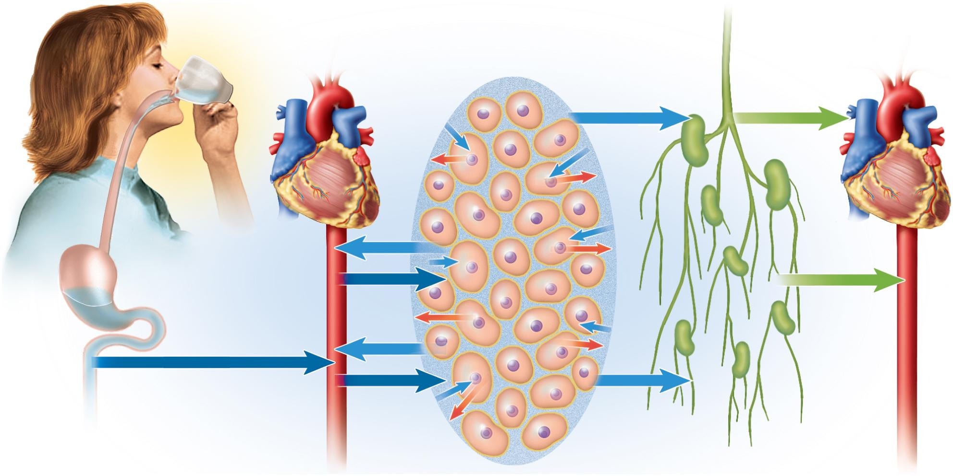
Water Movement Between Fluid Compartments
Copyright © The McGraw-Hill Companies, Inc. Permission required for reproduction or display.
Intracellular
fluid
Digestive tract
Bloodstream
Tissue fluid
Lymph
Bloodstream
Figure 24.1

Slide 9
In which of these compartments would fluid accumulate in edema?

Slide 10
Water Gain
fluid balance - when daily gains and losses are equal (about 2,500 mL/day)
gains come from two sources:
preformed water (2,300 mL/day)
ingested in food (700 mL/day) and drink (1600 mL/day)
metabolic water (200 mL/day)
by-product of aerobic metabolism and dehydration synthesis
C₆H₁₂O₆ + 6O₂ 6CO₂ + 6H₂O

Slide 11
Water Loss
sensible water loss is observable
1,500 mL/ day is in urine
200 mL/day is in feces
100 mL/day is sweat in resting adult
insensible water loss is unnoticed
300 mL/day in expired breath
400 mL/day is cutaneous transpiration
diffuses through epidermis and evaporates
does not come from sweat glands
loss varies greatly with environment and activity
obligatory water loss – output that is relatively unavoidable
expired air, cutaneous transpiration, sweat, fecal moisture, and urine output

Slide 12
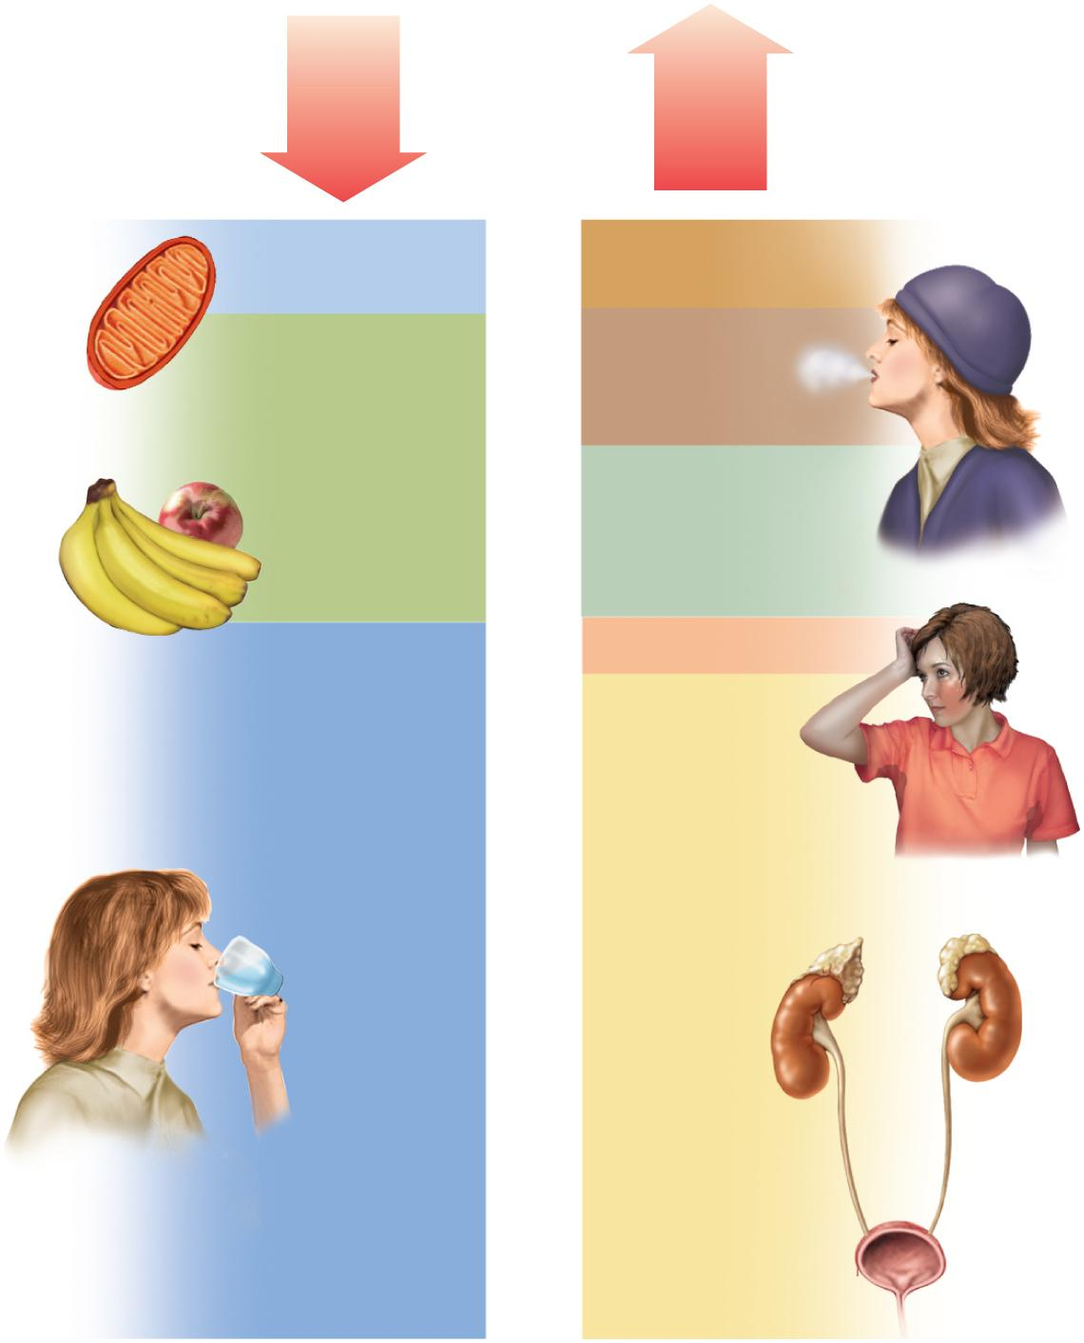
Fluid Balance
Intake
2,500 mL/day
Output
2,500 mL/day
Metabolic water
200 mL
Feces
200 mL
Expired air
300 mL
Food
700 mL
Copyright © The McGraw-Hill Companies, Inc. Permission required for reproduction or display.
Cutaneous
transpiration
400 mL
Sweat 100 mL
Drink
1,600 mL
Urine
1,500 mL
Figure 24.2

Slide 13
Regulation of Fluid Intake
thirst mainly governs fluid intake
dehydration
reduces blood volume and blood pressure
increases blood osmolarity
osmoreceptors in hypothalamus
respond to angiotensin II produced when BP drops and to rise in osmolarity of ECF with drop in blood volume
osmoreceptors communicate with the hypothalamus and cerebral cortex
hypothalamus produces antidiuretic hormone
promotes water conservation
cerebral cortex produces conscious sense of thirst
intense sense of thirst with 2-3% increase in plasma osmolarity or 10-15% blood loss
salivation is inhibited with thirst
sympathetic signals from thirst center to salivary glands

Slide 14
Thirst Satiation Mechanisms
long term inhibition of thirst
absorption of water from small intestine reduces osmolarity of blood
stops the osmoreceptor response, promotes capillary filtration, and makes the saliva more abundant and watery
changes require 30 minutes or longer to take effect
short term inhibition of thirst
cooling and moistening of mouth quenches thirst
distension of stomach and small intestine
30 to 45 min of satisfaction
must be followed by water being absorbed into the bloodstream or thirst returns
short term response designed to prevent overdrinking

Slide 15
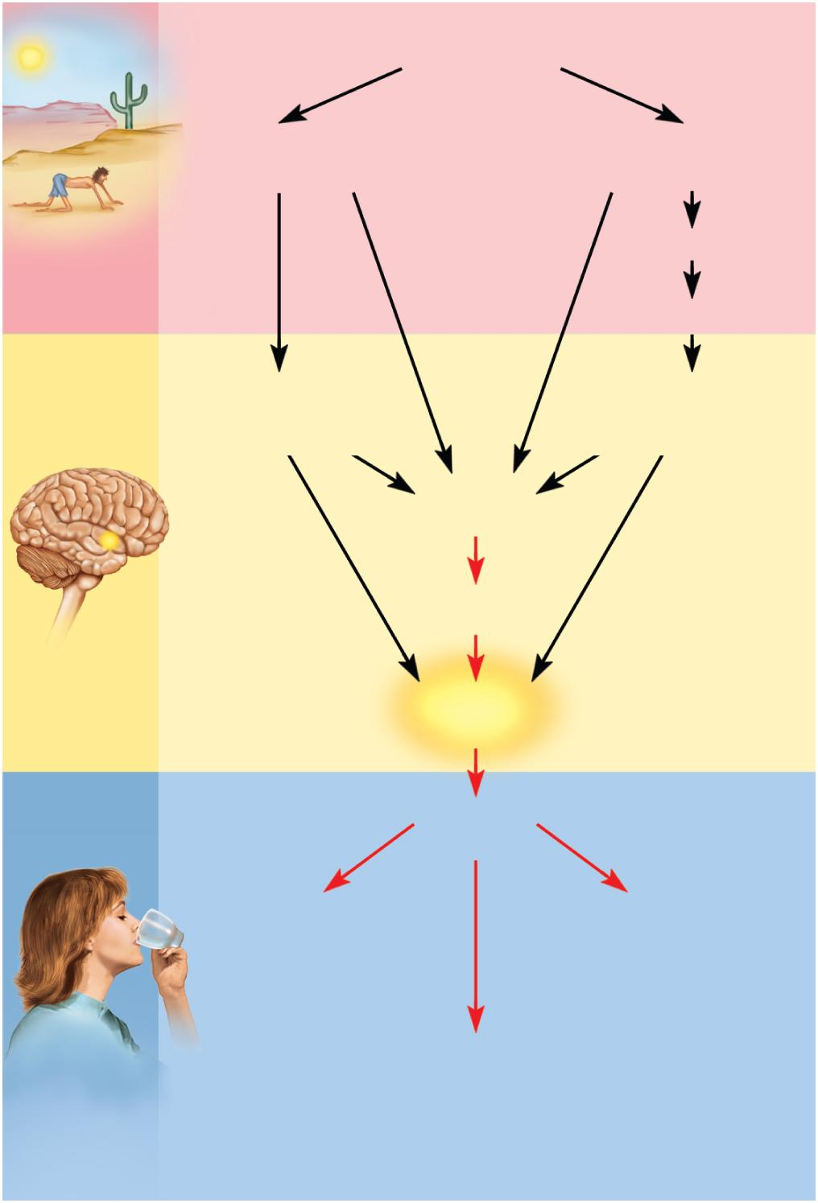
Dehydration, Thirst, and Rehydration
Copyright © The McGraw-Hill Companies, Inc. Permission required for reproduction or display.
Dehydration
Increased
blood osmolarity
Reduced
blood pressure
Renin
Dehydration
Angiotensin II
Stimulates
hypothalamic
osmoreceptors
Stimulates
hypothalamic
osmoreceptors
Reduced
salivation
Dry mouth
?
Thirst
Sense of
thirst
Ingestion
of water
Cools and
moistens mouth
Distends
stomach
and intestines
Short-term
inhibition
of thirst
Figure 24.3
Long-term
inhibition
of thirst
Rehydration
Rehydrates
blood

Slide 16
Regulation of Water Output
only way to control water output significantly, is through variation in urine volume
kidneys can’t replace water or electrolytes
only slow rate of water and electrolyte loss until water and electrolytes can be ingested
mechanisms:
changes in urine volume linked to adjustments in Na⁺ reabsorption
as Na⁺ is reabsorbed or excreted, water follows
concentrate the urine through action of ADH
ADH secretion stimulated by hypothalamic osmoreceptors in response to dehydration
aquaporins synthesized in response to ADH
membrane proteins in renal collecting ducts whose job is to channel water back into renal medulla, Na⁺ is still excreted
slows decrease in water volume and increased osmolarity – concentrates urine
ADH release inhibited when blood volume and pressure is too high or blood osmolarity too low
effective way to compensate for hypertension

Slide 17
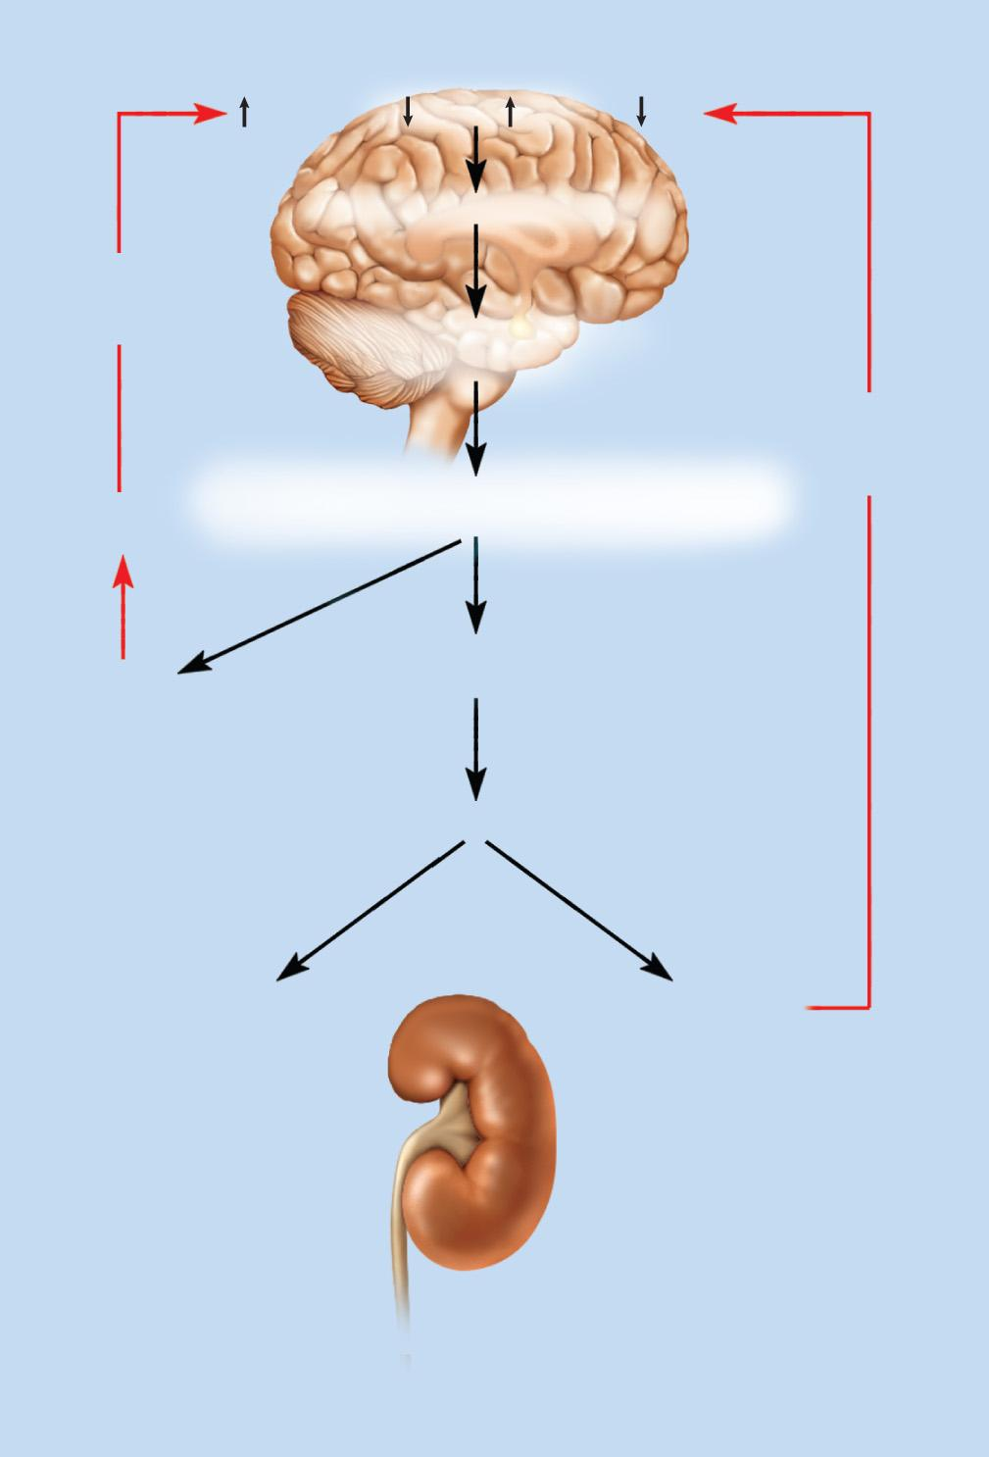
Secretion and Effects of ADH
Copyright © The McGraw-Hill Companies, Inc. Permission required for reproduction or display.
Dehydration
H₂O
H₂O
Na⁺
Na⁺
Elevates blood osmolarity
Negative
feedback
loop
Stimulates hypothalamic
osmoreceptors
Negative
feedback
loop
Water
ingestion
Stimulates posterior pituitary
to release antidiuretic hormone (ADH)
Thirst
Stimulates distal convoluted
tubule and collecting duct
Increases water reabsorption
Reduces urine
volume
Increases ratio
of Na⁺: H₂O
in urine
Figure 24.4

Slide 18
Disorders of Water Balance
the body is in a state of fluid imbalance if there is an abnormality of total volume, concentration, or distribution of fluid among the compartments
fluid deficiency – fluid output exceeds intake over long period of time
volume depletion (hypovolemia)
occurs when proportionate amounts of water and sodium are lost without replacement
total body water declines, but osmolarity remains normal
hemorrhage, severe burns, chronic vomiting, or diarrhea
dehydration (negative water balance)
body eliminates significantly more water than sodium
total body water declines, osmolarity rises
lack of drinking water, diabetes, ADH hyposecretion (diabetes insipidus), profuse sweating, overuse of diuretics
infants more vulnerable to dehydration than adults due to high metabolic rate that demands high urine excretion, immature kidneys cannot concentrate urine effectively, greater ratio of body surface to mass
affects all fluid compartments (ICF, blood, and tissue fluid)
most serious effects:
circulatory shock due to loss of blood volume, neurological dysfunction due to dehydration of brain cells, infant mortality from diarrhea

Slide 19
Fluid Balance in Cold Weather
the body conserves heat by constricting blood vessels of the skin forcing blood to deeper circulation
raises blood pressure which inhibits secretion of ADH
increases secretion of atrial natriuretic peptide
urine output is increased and blood volume reduced
cold air is drier and increases respiratory water loss also reducing blood volume
cold weather respiratory and urinary loses cause a state of reduced blood volume (hypovolemia)
exercise will dilate vessels in skeletal muscles
insufficient blood for rest of the body can bring on weakness, fatigue, or fainting (hypovolemic shock)

Slide 20
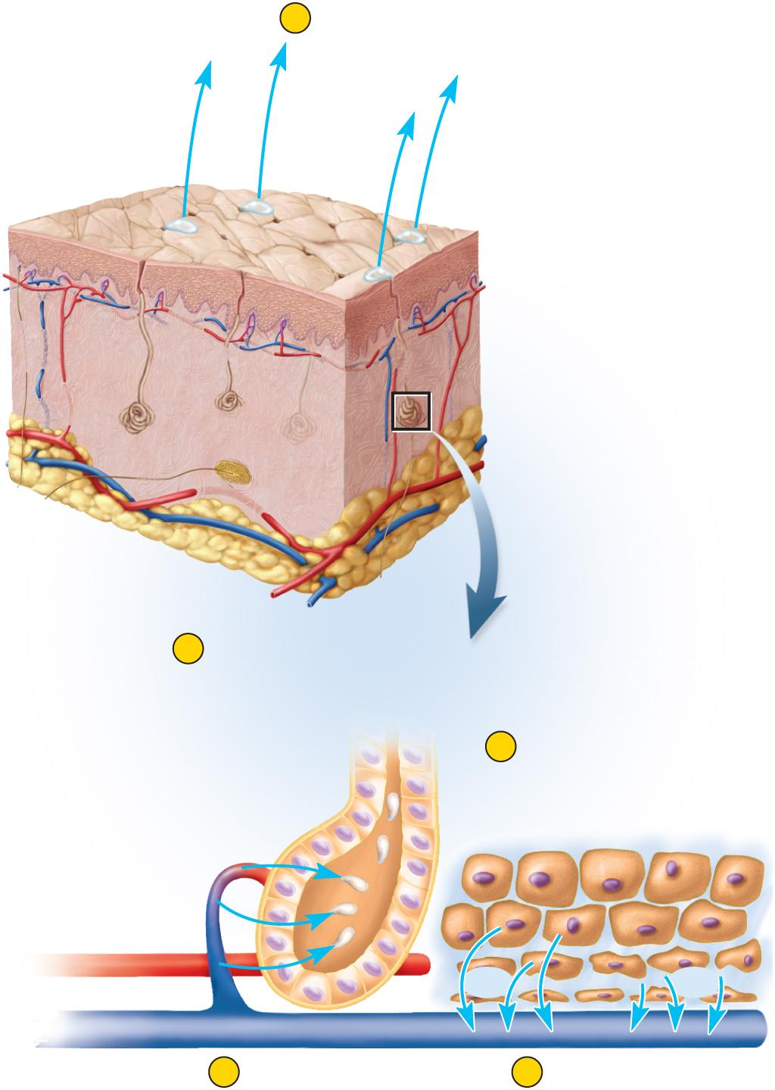
Dehydration from Excessive Sweating
Copyright © The McGraw-Hill Companies, Inc. Permission required for reproduction or display.
1) water loss from sweating
2) sweat produced by capillary filtration
3) blood volume and pressure drop, osmolarity rises
4) blood absorbs tissue fluid to replace loss
5) tissue fluid pulled from ICF
6) all three compartments lose water
7) 300 mL from tissue fluid and 700 mL from ICF
1
Water loss
(sweating)
H₂O
H₂O
H₂O
Skin
Sweat pores
Sweat gland
2
Sweat glands
produce perspiration
by capillary
filtration.
5
Intracellular fluid
diffuses out of
cells to replace
lost tissue fluid.
Secretory cells
of sweat gland
H₂O
H₂O
H₂O
H₂O
3
Blood volume
and pressure drop;
osmolarity rises.
4
Blood absorbs tissue
fluid to replace loss.
Figure 24.5

Slide 21
Fluid Excess
fluid excess – less common than fluid deficiency because the kidneys are highly effective in compensating for excessive intake by excreting more urine
renal failure can lead to fluid retention
two types of fluid excesses
volume excess
both Na⁺ and water retained
ECF remains isotonic
caused by aldosterone hypersecretion or renal failure
hypotonic hydration (water intoxication) (positive water balance)
more water than Na⁺ retained or ingested
ECF becomes hypotonic
can cause cellular swelling
pulmonary and cerebral edema

Slide 22
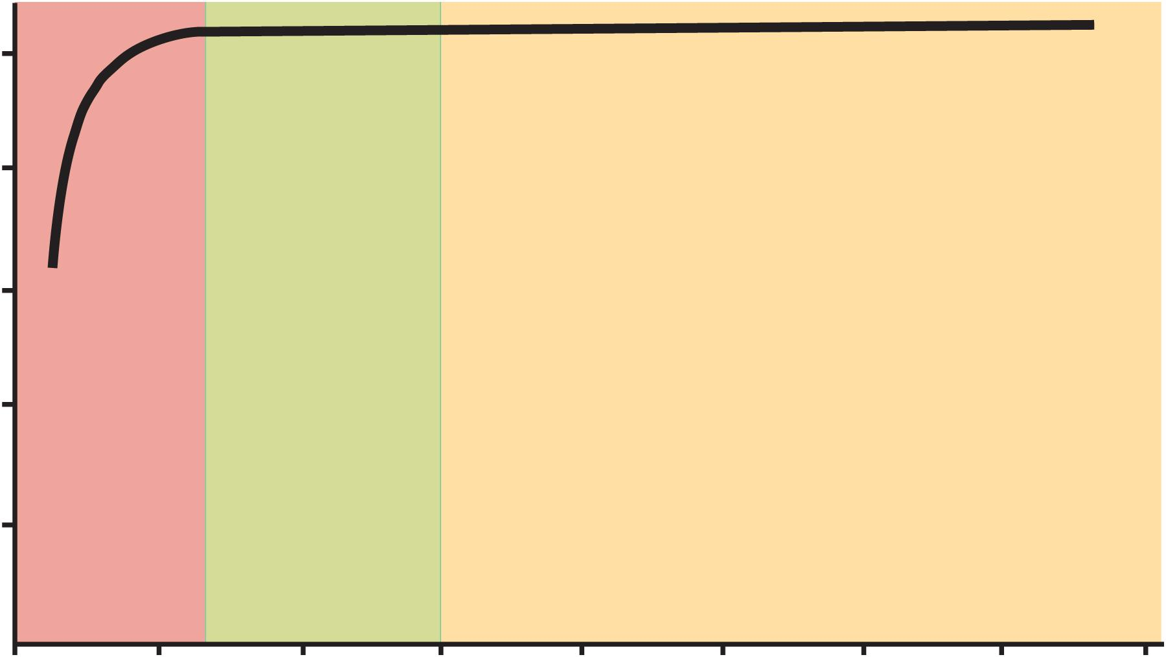
Blood Volume and Fluid Intake
Copyright © The McGraw-Hill Companies, Inc. Permission required for reproduction or display.
5
4
Hypovolemia
3
Death
Blood volume (L)
2
1
Danger
Normal
Water diuresis
0
0
1
2
3
4
5
6
7
8
Fluid intake (L/day)
Figure 24.6
kidneys compensate very well for excessive fluid intake, but not for inadequate fluid intake

Slide 23
Fluid Sequestration
fluid sequestration – a condition in which excess fluid accumulates in a particular location
total body water may be normal, but volume of circulating blood may drop to a point causing circulatory shock
most common form: edema - abnormal accumulation of fluid in the interstitial spaces, causing swelling of the tissues
hemorrhage - another cause of fluid sequestration
blood that pools in the tissues is lost to circulation
pleural effusion – several liters of fluid can accumulate in the pleural cavity
caused by some lung infections

Slide 24
PART II

Slide 25
LEARNING OUTCOMES
As a result of the lesson you will be able to:
Describe the physiological roles of sodium, potassium, chloride, calcium, magnesium, and phosphates;
Describe the hormonal and renal mechanisms that regulate the concentrations of these electrolytes;
state the term for an excess or deficiency of each electrolyte and describe the consequences of these imbalances.
Al-Farabi Kazakh National University
Higher School of Medicine

Slide 26
Electrolyte Balance
physiological functions of electrolytes
chemically reactive and participate in metabolism
determine electrical potential (charge difference) across cell membranes
strongly affect osmolarity of body fluids
affect body’s water content and distribution
major cations
Na⁺, K⁺, Ca²⁺, and H⁺
major anions
Cl⁻, HCO₃⁻ (bicarbonate), and PO₄³⁻
great differences between electrolyte concentrations of blood plasma and intracellular fluid (ICF)
have the same osmolarity (300 mOsm/L)
concentrations in tissue fluid (ECF) differ only slightly from those in the plasma

Slide 27
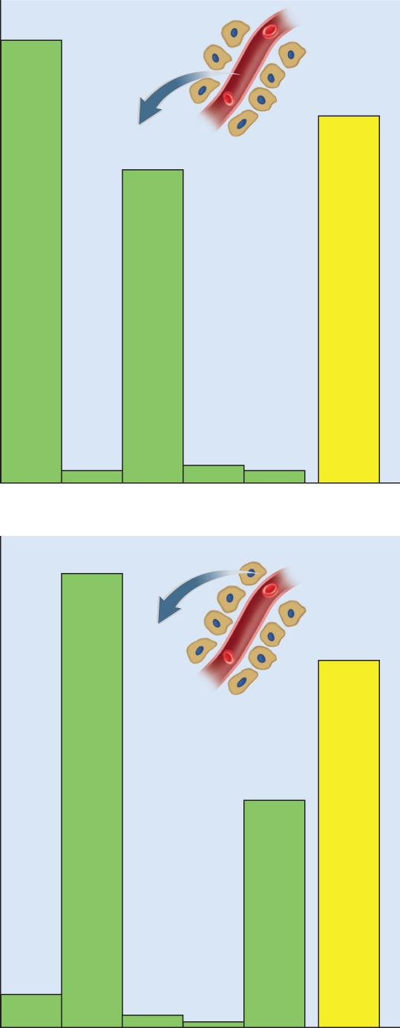
Electrolyte Concentrations
Copyright © The McGraw-Hill Companies, Inc. Permission required for reproduction or display.
145
300
103
4
5
4
(a) Blood plasma
150
300
75
12
4
Figure 24.7
< 1
Na⁺
K⁺
Cl–
Ca²⁺
P_{i}
Osmolarity
(mOsm/L)
(mEq/L)
(b) Intracellular fluid

Slide 28
Sodium - Functions
sodium - principal ions responsible for the resting membrane potentials
inflow of sodium through membrane gates is an essential event in the depolarization that underlies nerve and muscle function
principal cation in ECF
sodium salts accounts for 90 - 95% of osmolarity of ECF
most significant solute in determining total body water and distribution of water among the fluid compartments
Na⁺ gradient a source of potential energy for cotransport of other solutes such as glucose, potassium, and calcium
Na⁺- K⁺ pump
exchanges intracellular Na⁺ for extracellular K⁺
generates body heat
NaHCO₃ has major role in buffering pH in ECF

Slide 29
Sodium - Homeostasis
adult needs about 0.5 g of sodium per day
typical American diet contains 3 – 7 g/day
primary concern - excretion of excess dietary sodium
sodium concentration coordinated by:
aldosterone - “salt retaining hormone”
primary role in adjusting sodium excretion
hyponatremia and hyperkalemia directly stimulate the adrenal cortex to secrete aldosterone
hypertension stimulates its secretion by way of the renin-angiotensin-aldosterone mechanism
aldosterone receptors in ascending limb of nephron loop, the distal convoluted tubule, and cortical part of collecting duct
aldosterone, a steroid, binds to nuclear receptors
activates transcription of a gene for the Na⁺ -K⁺ pumps
in 10 – 30 minutes enough Na⁺ -K⁺ pumps are inserted in the plasma membrane to make a noticeable effect
tubules reabsorb more sodium and secrete more hydrogen and potassium
water and chloride passively follow sodium
primary effects of aldosterone are that the urine contains less NaCl and more potassium and a lower pH

Slide 30
Sodium - Homeostasis
elevated blood pressure inhibits the renin-angiotensin-aldosterone mechanism
kidneys reabsorb almost no sodium
urine contains up to 30 g of sodium per day instead of normal 5 g
ADH – modifies water excretion independently of sodium excretion
high sodium concentration in the blood stimulate the posterior lobe of the pituitary to release ADH
kidneys reabsorbs more water
slows down any further increase in blood sodium concentration
drop in sodium inhibits ADH release
more water is excreted, raising the sodium level in the blood
ANP (atrial natriuretic peptide) and BNP (brain natriuretic peptide )
inhibit sodium and water reabsorption, and the secretion of renin and ADH
kidneys eliminate more sodium and water lowering blood pressure
others:
estrogen mimics aldosterone and women retain water during pregnancy
progesterone reduces sodium reabsorption and has a diuretic effect
sodium homeostasis is achieved by regulating salt intake
salt cravings in humans and other animals

Slide 31
Sodium - Imbalances
hypernatremia
plasma sodium concentration greater than 145 mEq/L
from administration of IV saline
water pretension, hypertension and edema
hyponatremia
plasma sodium concentration less than 130 mEq/L
person loses large volumes of sweat or urine, replacing it with drinking plain water
result of excess body water, quickly corrected by excretion of excess water

Slide 32
Potassium - Functions
most abundant cation of ICF
greatest determinant of intracellular osmolarity and cell volume
produces (with sodium) the resting membrane potentials and action potentials of nerve and muscle cells
Na⁺-K⁺ pump
co-transport and thermogenesis
essential cofactor for protein synthesis and other metabolic processes

Slide 33
Potassium - Homeostasis
potassium homeostasis is closely linked to that of sodium
90% of K⁺ in glomerular filtrate is reabsorbed by the PCT
rest excreted in urine
DCT and cortical portion of collecting duct secrete K⁺ in response to blood levels
Aldosterone stimulates renal secretion of K⁺

Slide 34
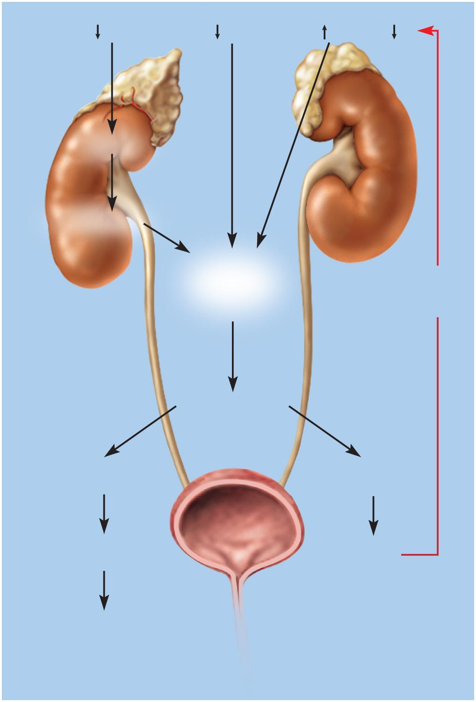
Secretion and Effects of Aldosterone
Copyright © The McGraw-Hill Companies, Inc. Permission required for reproduction or display.
Hypotension
Hyponatremia
Hyperkalemia
H₂O
Na⁺
K⁺
K⁺
Renin
Angiotensin
Stimulates
adrenal cortex
to secrete
aldosterone
Negative
feedback
loop
Stimulates renal
tubules
Increases Na⁺
reabsorption
Increases K⁺
secretion
Less Na⁺
and H₂O in urine
More K⁺
in urine
Supports existing
fluid volume and
Na⁺ concentration
pending oral intake
Figure 24.8

Slide 35
Potassium - Imbalances
most dangerous imbalances of electrolytes
hyperkalemia - effects depend on whether the potassium concentration rises quickly or slowly
greater than 5.5 mEq/L
if concentration rises quickly, (crush injury) the sudden increase in extracellular K⁺ makes nerve and muscle cells abnormally excitable
slow onset, inactivates voltage-regulated Na⁺ channels, nerve and muscle cells become less excitable
can produce cardiac arrest
hypokalemia
less than 3.5 mEq/L
rarely results from dietary deficiency
from sweating, chronic vomiting or diarrhea
nerve and muscle cells less excitable
muscle weakness, loss of muscle tone, decreased reflexes, and arrhythmias from irregular electrical activity in the heart

Slide 36
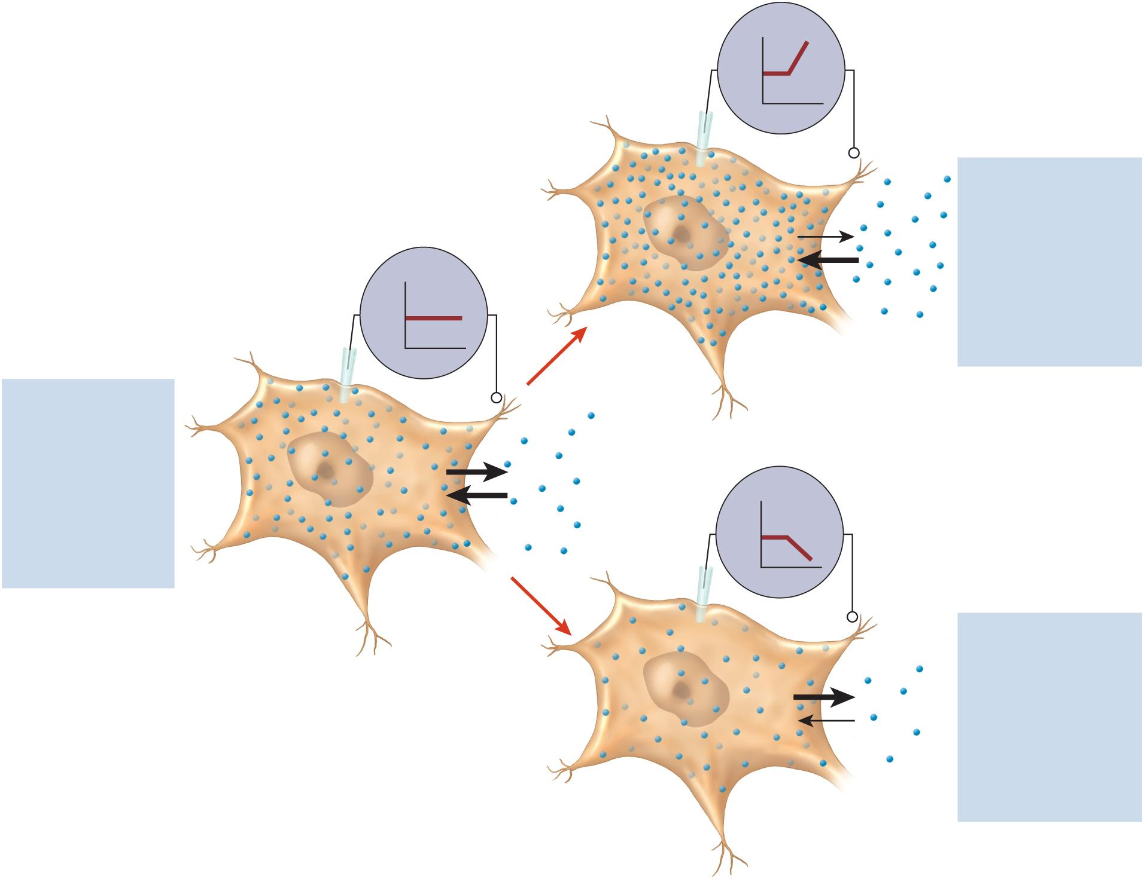
Potassium & Membrane Potentials
Copyright © The McGraw-Hill Companies, Inc. Permission required for reproduction or display.
+
mV
–
Elevated extracellular
K⁺ concentration
Less diffusion of K⁺
out of cell
+
RMP
Elevated RMP (cells
partially depolarized)
mV
K⁺
–
Cells more excitable
K⁺ concentrations
in equilibrium
(b) Hyperkalemia
Equal diffusion into
and out of cell
Normal resting
membrane
potential (RMP)
+
mV
–
Reduced extracellular
K⁺ concentration
(a) Normokalemia
Greater diffusion of
K⁺ out of cell
Reduced RMP (cells
hyperpolarized)
Figure 24.9
Cells less excitable
(c) Hypokalemia

Slide 37
In Some tumors of the adrenal cortex secrete excess aldosterone and may cause paralysis. Explain this effect and identify the electrolyte and fluid imbalances you would expect to observe in such a case.

Slide 38
Chloride - Functions
most abundant anions in ECF
major contribution to ECF osmolarity
required for the formation of stomach acid
hydrochloric acid (HCl)
chloride shift that accompanies CO₂ loading and unloading in RBCs
major role in regulating body pH

Slide 39
Chloride - Homeostasis
strong attraction to Na⁺, K⁺ and Ca²⁺, which chloride passively follows
primary homeostasis achieved as an effect of Na⁺ homeostasis
as sodium is retained, chloride ions passively follow

Slide 40
Chloride - Imbalances
hyperchloremia
result of dietary excess or administration of IV saline
hypochloremia
side effect of hyponatremia
sometimes from hyperkalemia or acidosis
primary effects:
disturbances in acid-base balance

Slide 41
Calcium - Functions
lends strength to the skeleton
activates sliding filament mechanism of muscle contraction
serves as a second messenger for some hormones and neurotransmitters
activates exocytosis of neurotransmitters and other cellular secretions
essential factor in blood clotting

Slide 42
Calcium - Homeostasis
calcium homeostasis is chiefly regulated by PTH, calcitriol (vitamin D), and calcitonin (in children)
these hormones affect bone deposition and resorption
intestinal absorption and urinary excretion
cells maintain very low intracellular Ca²⁺ levels
to prevent calcium phosphate crystal precipitation
phosphate levels are high in the ICF
cells must pump Ca²⁺ out
keeps intracellular concentration low
or sequester Ca²⁺ in smooth ER and release it when needed
calsequestrin – proteins that bind Ca²⁺ and keep it unreactive in Ca²⁺ storage cells

Slide 43
Calcium - Imbalances
hypercalcemia – greater than 5.8 mEq/L
alkalosis, hyperparathyroidism, hypothyroidism
reduces membrane Na⁺ permeability, inhibits depolarization of nerve and muscle cells
concentrations greater than 12 mEq/L causes muscular weakness, depressed reflexes, cardiac arrhythmias
hypocalcemia – less than 4.5 mEq/L
vitamin D deficiency, diarrhea, pregnancy, acidosis, lactation, hypoparathyroidism, hyperthyroidism
increases membrane Na⁺ permeability, causing nervous and muscular systems to be abnormally excitable
very low levels result in tetanus, laryngospasm, death

Slide 44
Phosphates - Functions
relatively concentrated in ICF due to hydrolysis of ATP and other phosphate compounds
inorganic phosphates (P_{i}) of the body fluids are an equilibrium mixture of phosphate (PO₄³⁻), monohydrogen phosphate (HPO₄²⁻), and dihydrogen phosphate (H₂PO₄⁻)
components of:
nucleic acids, phospholipids, ATP, GTP, cAMP, and creatine phosphate
activates many metabolic pathways by phosphorylating enzymes and substrates such as glucose
buffers that help stabilize the pH of body fluids

Slide 45
Phosphates - Homeostasis
renal control
normally phosphate is continually lost by glomerular filtration
if plasma concentration drops, renal tubules reabsorb all filtered phosphate
parathyroid hormone
increases excretion of phosphate which increases concentration of free calcium in the ECF
lowering the ECF concentration of phosphate minimizes the formation of calcium phosphate and helps support plasma calcium concentration
imbalances not as critical
body can tolerate broad variations in concentration of phosphate

Slide 46
Girl Pulled Alive from Ruins, 15 Days after Earthquake
Part I
1. What are the physical signs and symptoms of Progressive dehydration, such as Darlene might have experienced?
Level of dehydration | Physical or physiological characteristics
2% body water loss | Thirst, lack of appetite, decreased urine output, increased cardio and respiratory function, decreased sweating.
5% body water loss | Sleepy, headache, nau sea, dimmed vision, increased body temperature, decreased urination, fatigue, muscle cramps, tingling in limbs
10% body water loss | Muscle spasms, shriveling and wrinkling of skin, lack of urination—painful, confusion, seizures, racing pulse, hypo and/or hyperthermia.
12% body water loss | Clinical shock; unconscious; depressed function of all organ systems.
Al-Farabi Kazakh National University
Higher School of Medicine

Slide 47
Girl Pulled Alive from Ruins, 15 Days after Earthquake
Part I
2. What do we know so far about Darlene’s physiological responses to her prolonged ordeal?
Conscious but weak
Weak pulse and low blood pressure
symptomatic of excessive extracellular water loss from the plasma volume.
Skin pinch test
excessive interstitial water loss from the skin
Administered oxygen
very low blood pressure was probably not adequately perfusing the central nervous system.
Al-Farabi Kazakh National University
Higher School of Medicine

Slide 48
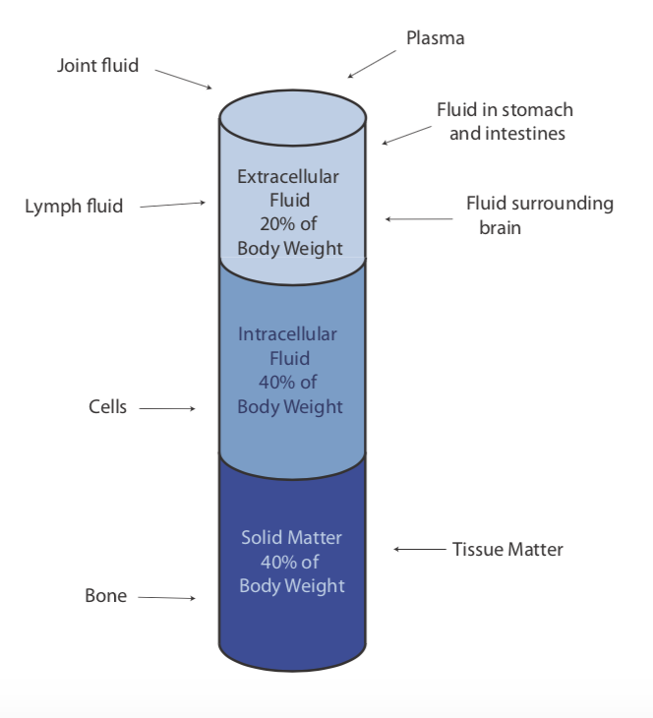
Girl Pulled Alive from Ruins, 15 Days after Earthquake
Part II
3. Based on the diagram (in Part II of the case study), what are the major water compartments of the body, and how does water move between them? What is the 60–40–20 rule for body water?
Water constitutes 60% of body mass,
2/3 of which is intracellular water
1/3 of which is extracellular water.
Thus 60–40–20 stands for total body water = 60% body mass;
intracellular water = 40% body mass;
extracellular water = 20% body mass.
The extracellular compartment consists of lymph, blood plasma, cerebrospinal fluid, digestive tract secretions and contents, joint fluid, and intercellular or interstitial fluid.
Al-Farabi Kazakh National University
Higher School of Medicine

Slide 49
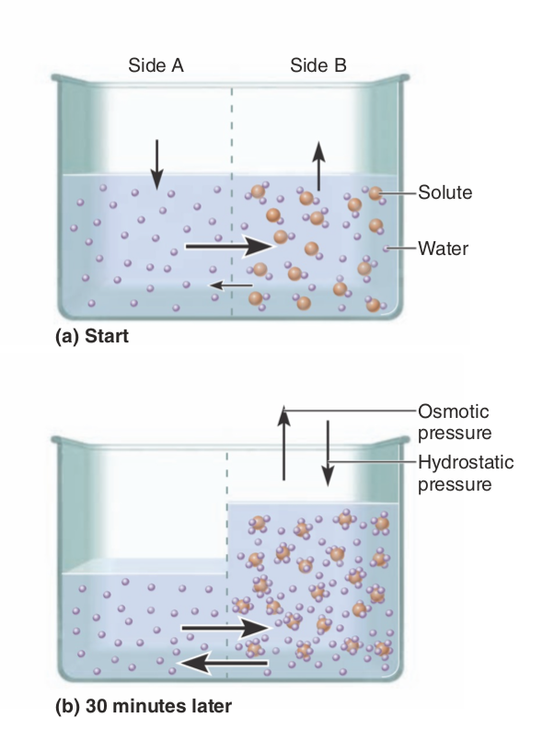
Girl Pulled Alive from Ruins, 15 Days after Earthquake
Osmosis
Water flows through cell membranes and epithelia by osmosis, from the side where it is more concentrated to the side where it is less so.
Water moves osmotically in response to solute concentrations on either side of permeable membranes. Intracellular water content is defended most vigorously, such that cellular function and integrity are maintained. As cells dehydrate, water will move from various extracellular components to offset the cellular loss.
Al-Farabi Kazakh National University
Higher School of Medicine

Slide 50
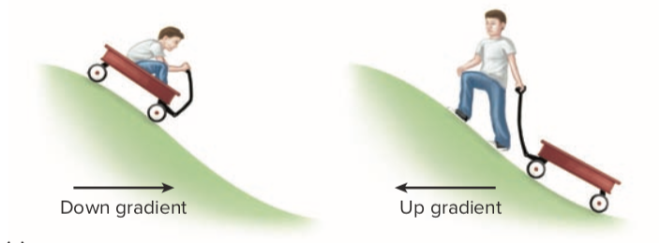
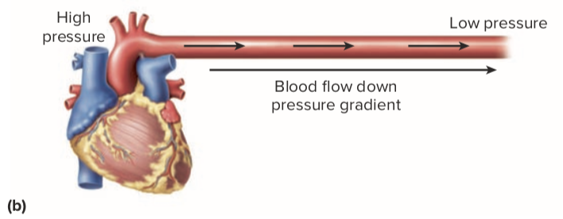
gradient
A physiological gradient is a difference in chemical concentration, electrical charge, physical pressure, temperature, or other variable between one point and another.
If matter or energy moves from the point where this variable has a higher value to the point with a lower value, we say it flows down the gradient—for example, from a warmer to a cooler point, or a place of high chemical concentration to one of lower concentration. Movement in the opposite direction is up the gradient.
(a) A wagon rolling downhill (down a gradient) (left) is a useful analogy to spontaneous, gradient-driven physiological processes. Moving up a gradient (right) requires an energy input.
(b) Blood flowing down a pressure gradient.
Al-Farabi Kazakh National University
Higher School of Medicine

Slide 51
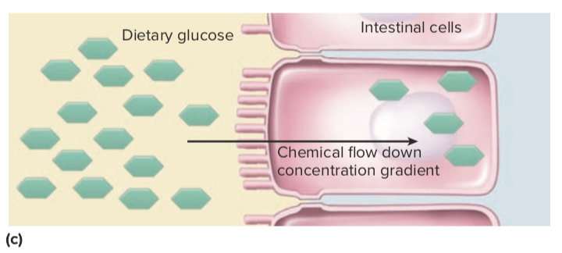
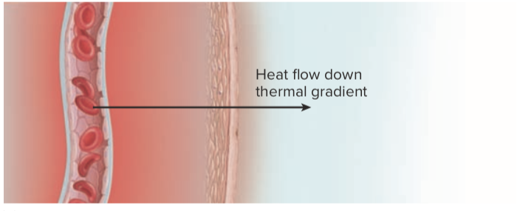
gradient
A physiological gradient is a difference in chemical concentration, electrical charge, physical pressure, temperature, or other variable between one point and another.
If matter or energy moves from the point where this variable has a higher value to the point with a lower value, we say it flows down the gradient—for example, from a warmer to a cooler point, or a place of high chemical concentration to one of lower concentration. Movement in the opposite direction is up the gradient.
(c) Dietary sugars flowing down a concentration gradient into an intestinal cell. e) Heat flowing down a thermal gradient to leave the body through the skin.
Al-Farabi Kazakh National University
Higher School of Medicine

Slide 52
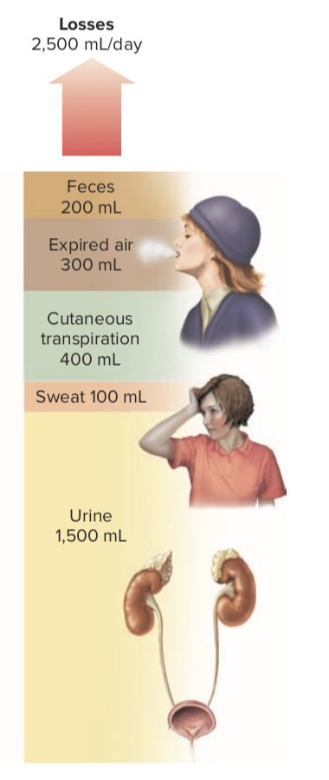
Girl Pulled Alive from Ruins, 15 Days after Earthquake
Part II
4. Assuming that Darlene did NOT have access to water during her entrapment, from what sources would her body begin to lose water? What are the specific avenues of water loss?
kidney (urine);
skin (insensible and active perspiration of sweating);
gut (secretions and excretion);
respiratory tract (evaporation from mucosal surfaces and loss of water in exhalation).
Al-Farabi Kazakh National University
Higher School of Medicine

Slide 53
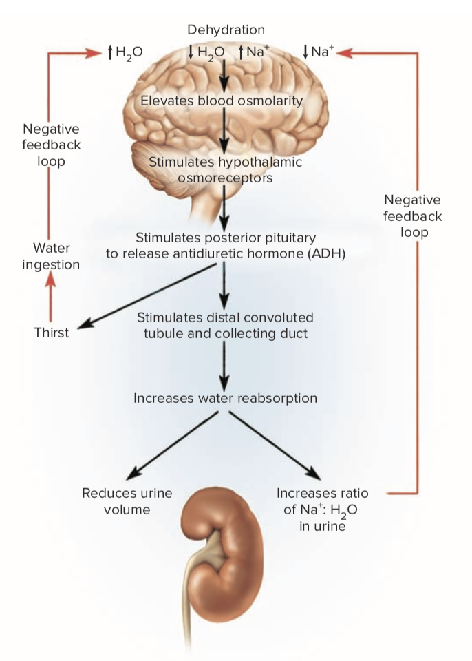
Girl Pulled Alive from Ruins, 15 Days after Earthquake
Part II
5. How might the body immediately begin to reduce those avenues of water loss in Question #4? What important physiological reflexes would be invoked to try to control the rate of water loss from those specific avenues?
Osmoreceptors in the hypothalamus would detect increases in osmotic concentration of the blood as plasma volume is pulled into dehydrating cells. This triggers the release of Anti-Diuretic Hormone (ADH, also known as vasopressin) from hypothalamic neurons via the posterior pituitary into the general circulation. The target organ, renal tubules, and collecting ducts place more aquaporin channels into their cell membranes, with the result that more water in the urine filtrate is absorbed and returned to the vascular system.
Al-Farabi Kazakh National University
Higher School of Medicine

Slide 54
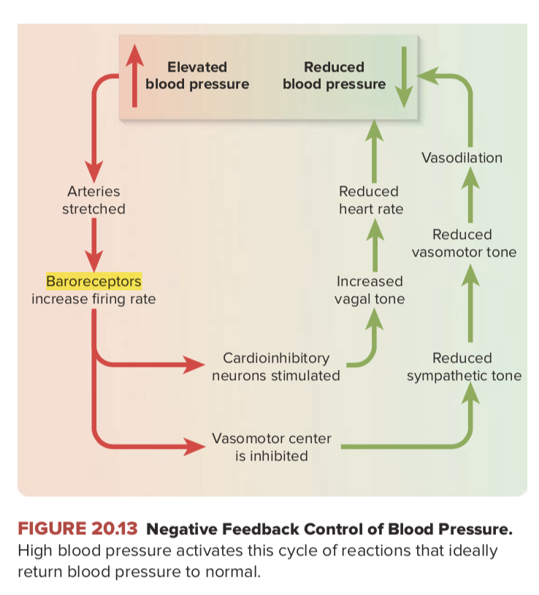
Girl Pulled Alive from Ruins, 15 Days after Earthquake
Part II
5. How might the body immediately begin to reduce those avenues of water loss in Question #4? What important physiological reflexes would be invoked to try to control the rate of water loss from those specific avenues?
baroreceptors in the aortic and carotid bodies may respond to decreased arterial blood pressure by reducing their input to the parasympathetic neurons of the medullary cardiovascular center. This allows more firing of the sympathetic neurons, which results in decreased blood flow (due to vasoconstriction) to non-essential organs, as well as increased heart rate and cardiac output. Reduced blood flow to areas of potential water loss would decrease the rate of water loss somewhat.
Al-Farabi Kazakh National University
Higher School of Medicine

Slide 55
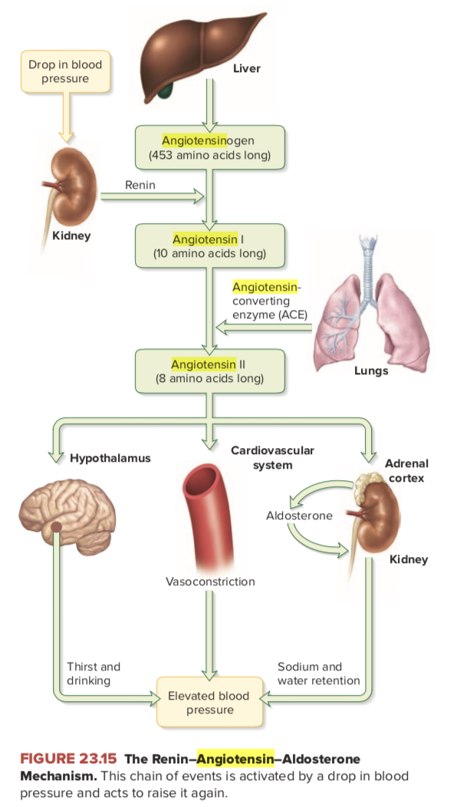
Girl Pulled Alive from Ruins, 15 Days after Earthquake
Part II
5. How might the body immediately begin to reduce those avenues of water loss in Question #4? What important physiological reflexes would be invoked to try to control the rate of water loss from those specific avenues?
Decreased renal blood flow through the glomerulus and/ or decreased Na+ ion concentration in the filtrate of distal tubules of the nephron (as a result of low blood flow through the kidney) trigger the release of renin from juxtaglomerular cells. Renin, in turn, catalyzes the formation of Angiotensin I (from an inactive form circulating in the plasma), which causes further vasoconstriction and reduced blood flow to non-essential tissues. As the blood flows through the lung, Angiotensin I is converted to Angiotensin II, which stimulates the adrenal cortex to release aldosterone. In response to increased aldosterone levels, the rate of sodium reabsorption from renal tubules increases. Water follows the solutes, thus increasing water reabsorption as well.
Al-Farabi Kazakh National University
Higher School of Medicine

Slide 56
The neuroendocrine reflex in ADH secretion is an example of homeostasis.
Dehydration triggers a reflex that ultimately promotes water conservation by the kidneys, thus helping to maintain a homeostatic state of water balance.
Dehydration, loss of blood volume, and rising blood osmolarity stimulate arterial baroreceptors and hypothalamic osmoreceptors. In response, the posterior pituitary gland secretes ADH. ADH makes the collecting duct more permeable to water, so water in the tubular fluid reenters the tissue fluid and blood rather than being lost in the urine. Its mechanisms of doing so are described later.
Al-Farabi Kazakh National University
Higher School of Medicine
Notes:
acbbcdae

Slide 57
Girl Pulled Alive from Ruins, 15 Days after Earthquake
Part II
6.How would changes in blood flow to specific organs help Darlene resist dehydration? Consider how reduction of function in particular organ systems might help conserve water.
a. Renal blood flow and renal function
Blood pressure drives the filtration pressure at the glomerulus and thus directly affects the formation rate of urine. Lower bloop pressure as a result of water loss from the plasma or vasoconstriction of renal circulation would reduce urinary water loss.
b.Gut blood flow and digestive function
Vasoconstriction of intestinal blood flow would reduce the secretory rate of intestinal epithelium, greatly reducing the amount of water lost to digestive processes and excretion. In addition, starvation also reduces gut function and the potential for water loss from this avenue
c. Skin blood flow and thermoregulation
Vasoconstriction of the skin not only reduces insensible water loss, but decreases the potential for water loss due to sweating. As a result, body temperature may rise (hyperthermia) during the daytime, but lack of blood flow to the skin at night would protect the body somewhat against hypothermia.
Al-Farabi Kazakh National University
Higher School of Medicine

Slide 58
Girl Pulled Alive from Ruins, 15 Days after Earthquake
Part II
6.How would changes in blood flow to specific organs help Darlene resist dehydration? Consider how reduction of function in particular organ systems might help conserve water.
d. Muscle blood flow, metabolism, and thermoregulation
The body enters a hypometabolic state, with relaxation of body temperature control, during starvation, and this actually provides some protection from water loss. Reduction of muscle tone and decreased oxidative process result in a lower metabolic rate and lowered evaporative water loss from the respiratory tract. By allowing body temperature to decrease at night (less shivering), metabolic expenses and respiratory water loss can be minimized then, just as the tolerance of hyperthermia during the daytime minimizes the water loss through the skin from sweating.
e. CNS blood flow and mental function
Whereas other organ systems accommodate to reduced blood flow during dehydration, blood flow to the central nervous system must be maintained to preserve the ability to respond to the physiological challenge. Mental function becomes compromised with as little as 5% total body water loss, and progressively diminishes as water loss reaches as little as 10–12% of total body water in humans. It is interesting to note here that humans are particularly sensitive to loss of total body water. Desert animals can tolerate much greater losses (e.g., camels withstand losses of 25% of total body water and can rehydrate with one drinking bout).
Al-Farabi Kazakh National University
Higher School of Medicine

Slide 59
Girl Pulled Alive from Ruins, 15 Days after Earthquake
Part II
7. Calculation of Darlene’s water loss—enter answers in the spaces and table below as directed.
7a. Total body water in liters (55 kg human) 55X60%=33L
7b. 12% of total body water in liters 3.96 L
7b. 20% of total body water in liters 6.6 L
Condition | Rate of water loss | Darlene’s survival time in days
7c. Average water loss for young adult females, 12% body water loss | 2.7 L/day | 1.47 days
7c. Average water loss during summer for European women (55 kg), 12% body water loss | 3.3 L/day | 1.2 days
7e. Absolute minimal water loss rate possible in humans, 12% total body water loss | 1.2–1.4 L/day | About 3 days (2.8–3.3)
7f. Absolute minimal water loss rate possible in humans, and 20% total body water loss | 1.2 L/day | About 5.5 days
Al-Farabi Kazakh National University
Higher School of Medicine

Slide 60
Girl Pulled Alive from Ruins, 15 Days after Earthquake
Part II
7d. Are these water loss values of any use in predicting how much water Darlene might have lost per day? Justify your answer.
Since water loss increases with age (and weight) as a result of the increase in daily energy cost per person, these comparisons might not be good predictors for someone Darlene’s age and weight. In addition, theses data were obtained for women that were well hydrated and engaging in normal daily activity (excluding exercise); hence they would likely overestimate water loss for someone undergoing starvation and dehydration.
Al-Farabi Kazakh National University
Higher School of Medicine

Slide 61
Girl Pulled Alive from Ruins, 15 Days after Earthquake
Part II
7g.Now, based on these calculations, could Darlene have survived 15 days without water? Explain the basis for your answer.
Obviously, the predicted days of survival at any of these rates of water loss is far less than the 15 days that Darlene survived. Something else must account for her survival.
such as being buried in rubble in the warm, humid environment , age, weight, or sex , Darlene was born and raised in Haiti , starvation
Al-Farabi Kazakh National University
Higher School of Medicine

